Slide 1
Computer ARCHITECTURE (CA)
Course Instructor
Hira beenish
Department of Computer Science

Slide 2
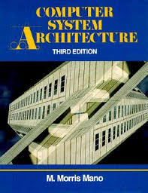
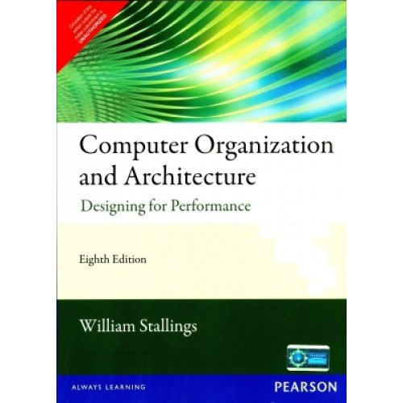
Recommended Books
Computer Systems Architecture, 3rd Edition
By M.Morris Mano; Prentice Hall International
Computer Organization and Architecture Designing For Performance By William Stallings

Slide 3
Chapters Included
1. Digital logic circuits
2. Digital components
3. Data Representation
4. Memory organization
5. Basic Computer Organization & Design →→Mid Term
6. Central processing unit
7.Pilpeline & vector processing
8. Computer arithmetic
9. I/O & O/P organization
10. 10. Multiprocessors

Slide 4
Chapter#3 Data representation

Slide 5
Contents
Binary Numbers
Representation of negative numbers
Fraction numbers
IEEE 745 Single Precision
Basic Conversion

Slide 6
Binary numbers
Binary number is simply a number comprised of only 0's and 1's.
Computers use binary numbers because it's easy for them to communicate using electrical current -- 0 is off, 1 is on.
You can express any base 10 (our number system -- where each digit is between 0 and 9) with binary numbers.
The need to translate decimal number to binary and binary to decimal.
In binary system the base is 2. We have only two possible values 0 or 1.

Slide 7
Examples: decimal -- binary
Find the binary representation of 129_{10.}
Find the decimal value represented by the following binary representations:
10000011
10101010
Find the decimal number represented by 10011001 in excess notation.
100110002 = 27 + 24 + 23 + 20 = 128 + 16 +8 +1 = 15310
Excess value:
excess value = 153 – 27 = 152 – 128 = 25.

Slide 8
Representation of negative numbers
Is a representation of negative numbers possible
Unfortunately:
you can not just stick a negative sign in front of a binary number. (it does not work like that)
There are three methods used to represent negative numbers.
Signed magnitude notation
Excess notation notation
Two’s complement notation

Slide 9
Signed-Summary
In signed magnitude notation,
the most significant bit is used to represent the sign.
1 represents negative numbers
0 represents positive numbers.

Slide 10
Representation of negative numbers
In signed magnitude
the left-most bit represents the sign of the integer.
0 for positive numbers.
1 for negative numbers.
The remaining bits represent to magnitude of the numbers

Slide 11
Fraction Representation
To represent fraction we need other representations:
fixed point representation
floating point representation.

Slide 12
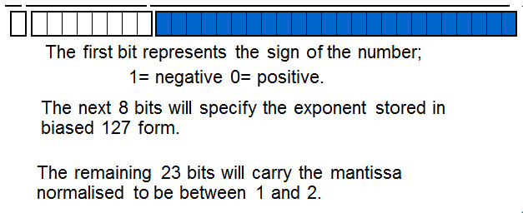
IEEE 745 Single Precision
The number will occupy 32 bits

Slide 13

Representation in IEEE 754 single precision
sign bit:
0 for positive and,
1 for negative numbers
8 biased exponent by 127
23 bit normalised mantissa

Slide 14
Basic Conversion
Converting a decimal number to a floating point number.
Take the integer part of the number and generate the binary equivalent
Take the fractional part and generate a binary fraction
Then place the two parts together and normalise.
6.75 in 32 bit floating point IEEE representation:-
0 10000001 10110000000000000000000

